Slide 1
SOKOBAN C# – Project Presentation
BCPR283 FINAL Assignment - Ashley Hiew 99153831

Slide 2
Table of Contents
Implement a view in Winforms using manually laid out components – Game Player
Build another Model different from Term 3 – File Handler
Implement a view in Winforms using dynamically laid out components – File Handler
Build a third Model different from Term 3 – Level Designer
Implement a view in Winforms using dynamically laid out components – Level Designer
Describe and use Common Design Patterns, Algorithms and programming language idioms
Design Programs
Design user interfaces which conform to recognised usability criteria

Slide 3
GAME PLAYER - View
Static lay-out of components

Slide 4
MUST-HAVE Features – Game Player MODEL
Display a grid of variable size (to an upper limit) CENTERED
Display the pieces as distinct images
Display the move count
Save and load ‘works’ (as in it passes to a Filer)
Is playable – Complete a level
Display the move history
Clicking the ‘Undo Move’ button displays the pieces to its previous state (previous user action)
User can restart a level

Slide 5
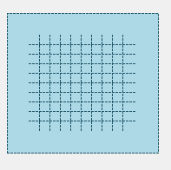
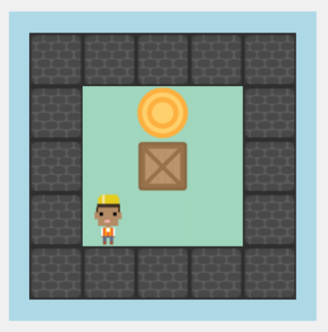
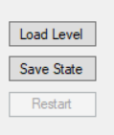
1. Display a grid of variable size (to an upper limit) CENTERED
The map (grid) is generated once the user has loaded a valid txt file by clicking the load level button.

Slide 6
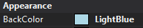
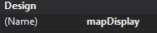
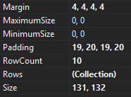
Static Implementation
With static view, I manually set up the properties of the component that displays the map. Setting the background colour, a name to be used by other methods, and the layout.

Slide 7
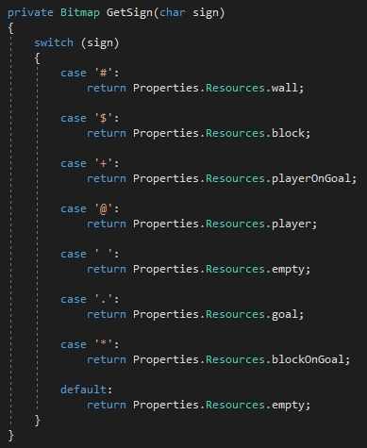
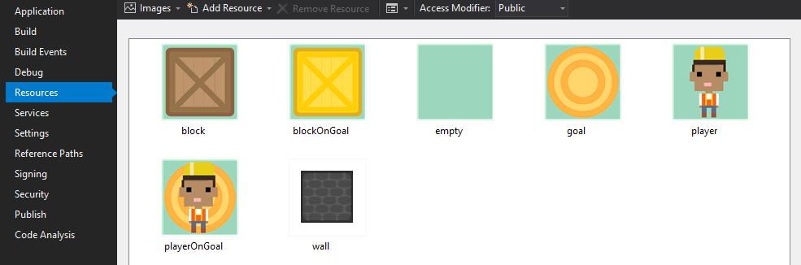
2. Display the pieces as distinct images
In the Properties folder, the images are added as resources and renamed according to their signs. The GetSign() method will return the appropriate image based on its character symbol its been assigned to.

Slide 8
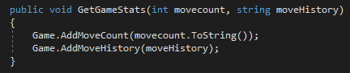
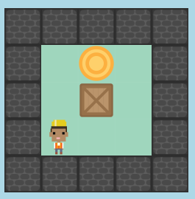
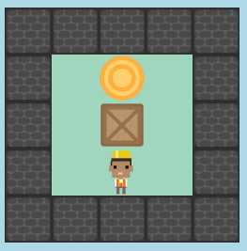
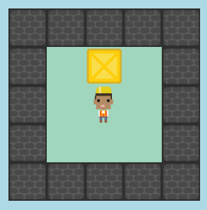
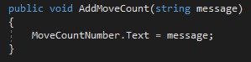
3. Display the move count
Each time the player moves, the GetGameStats() method is called and passes the current move count from GameController which is then set to MoveCountNumber.Text in the Windows Form for Game.
From GameFormView.cs:
Result:
Set as Text for MoveCountLabel
Set as Text for MoveCountNumber
From GameBoardForm.cs:

Slide 9
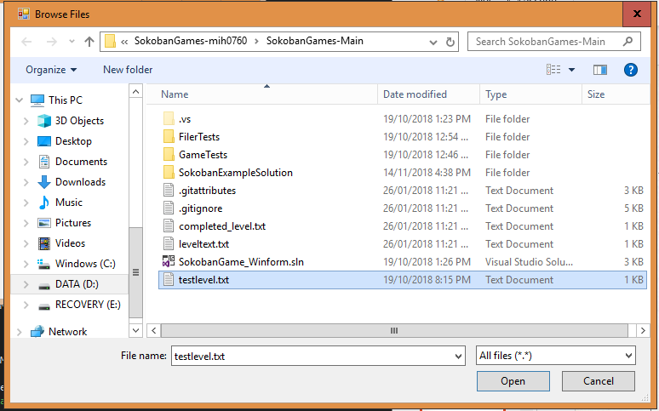
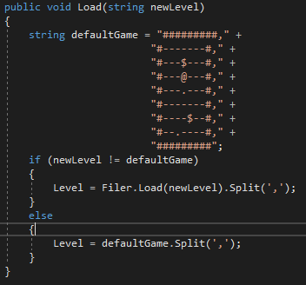
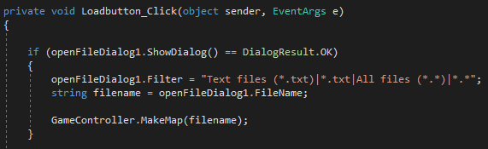
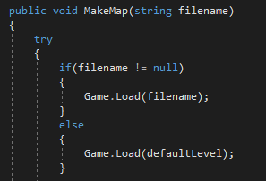
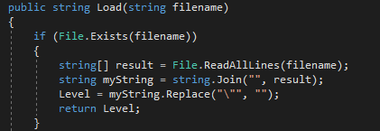
4. Save and load ‘works’ (as in it passes to a Filer)
LOAD: When Load Level button is clicked, it opens the openFile dialog which allows a user to select which txt file to load. When user clicks Open button, openFile dialog closes and map from selected txt file is displayed.
From Game.cs:
From GameBoardForm.cs:
From GameController.cs:
From GameFiler.cs:

Slide 10
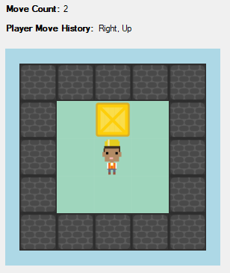
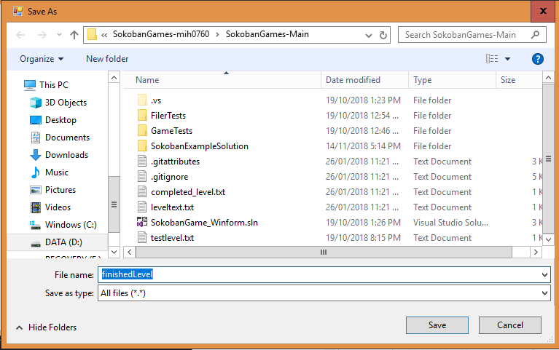
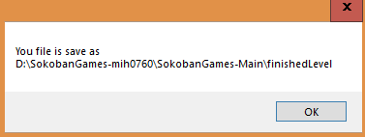
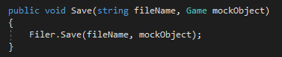
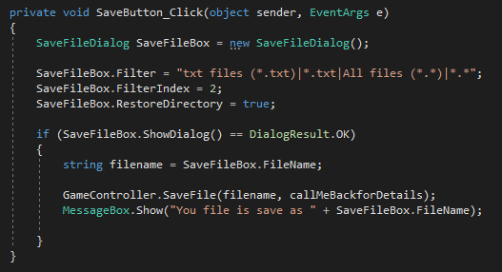
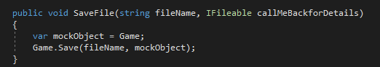
4. Save and load ‘works’ (as in it passes to a Filer)
SAVE: User can save the state of their game by clicking the Save State button which opens a saveFile dialog, prompting for a filename. When Save button is clicked, a message dialog is displayed indicating the file has been saved in a specific location.
From Game.cs:
From GameBoardForm.cs:
From GameController.cs:

Slide 11
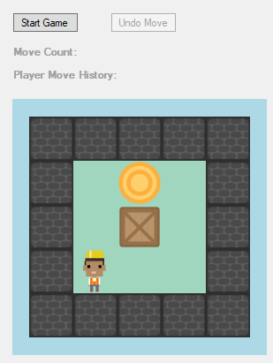
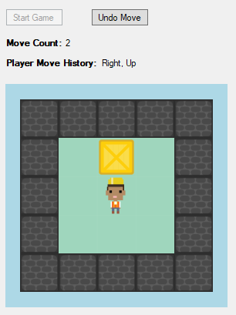
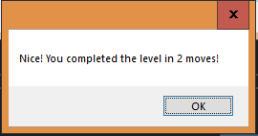
5. Is playable – Complete a level
When user clicks Start Game, the arrows on the keyboard can be used to move the player. Boxes are pushed by having the player go towards the direction of the box. When player completes a level. A dialog pops up indicating how many key presses the user has completed the level by.

Slide 12
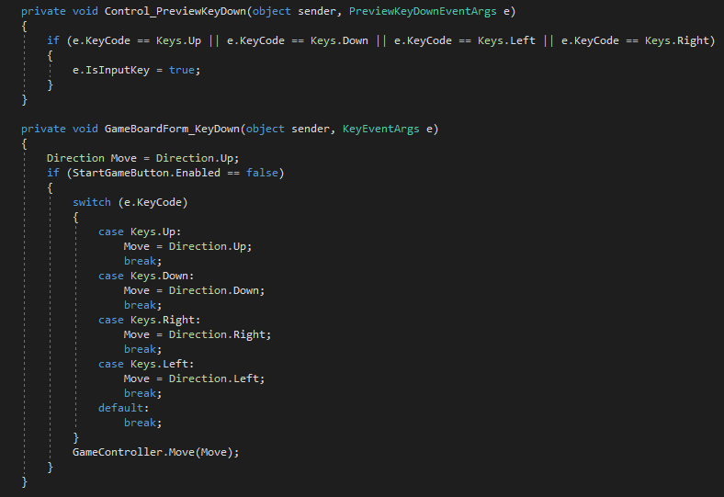
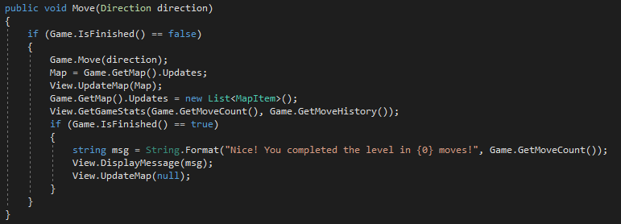
From GameBoardForm.cs:
Codes below shows that when a key is pressed, Move() method is called and player moves in the direction according to its case.
From GameController.cs:

Slide 13
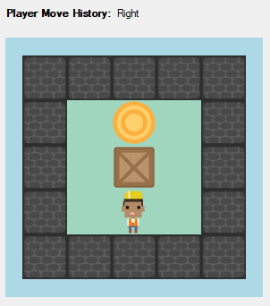
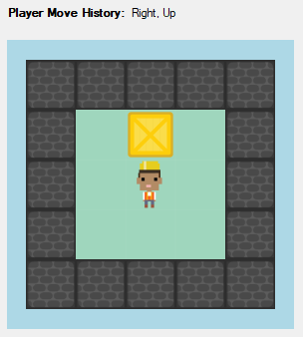
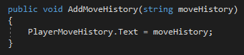
6. Display the move history
Each time the player moves, the GetGameStats() method is called and passes the string of the current move history from GameController which is then set to PlayerMoveHistory.Text in the Windows Form for Game. The maximum limit of move directions shown is 5. More than that replaces the least recent move.
From GameFormView.cs:
Set as Text for PlayerMoveHistoryLabel
Set as Text for PlayerMoveHistory
Result:
From GameBoardForm.cs:

Slide 14
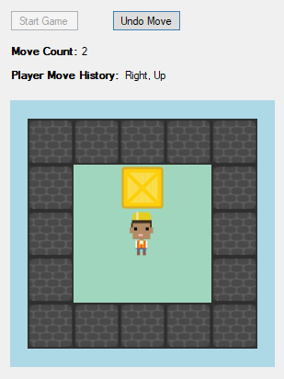
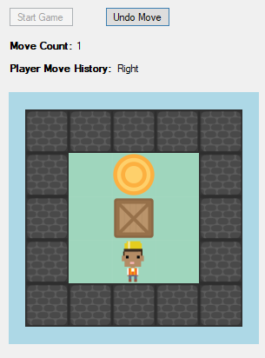
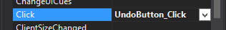
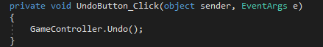
7. User can Undo a move
When Undo Move button is clicked, it triggers an event which calls the Undo() method from GameController, and reverts to the previous move, player move history, and move count.

Slide 15
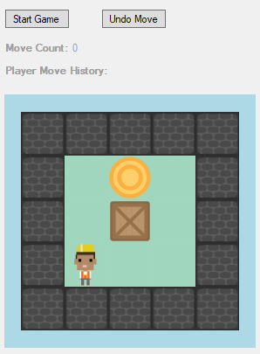
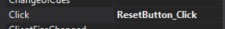
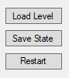
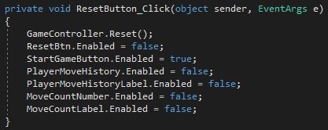
8. User can restart a level
When Restart Level button is clicked, it triggers the event that handles the ResetButton component which calls the Reset() method from GameController, clearing the state of the game, creating the map again, resetting the count and removing the player move history.
Before:
After:

Slide 16
Build another Model
File Handler

Slide 17
MUST HAVE FEATURES – FILE HANDLER MODEL
Get the width of loaded map array
Get the height of loaded map array
Validation Check – if correct file format
Validation Check – if file exists
Validation Check – Characters in file are valid symbols
Validation check – if player exists
Validation Check – no multiple players
Validation check – at least one block
Validation check – equal number of blocks and goals
Display any error messages from validation check
Get the name of the file
Set the default file extension to txt
Compress file
Expand file
Create a default “save” folder for map creations
Save map to file
Load map from file
Retrieve current directory
Save the current game state
Load file of a saved game state

Slide 18
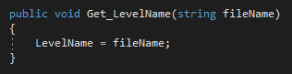
1. Get the name of the file
When the controller calls this method in the Filer, it sets the name of the file as LevelName and can be used in the Windows Form for FileHandler to be displayed with its actual map array.
From Filer.cs:

Slide 19
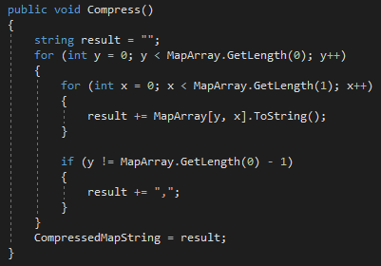
3. Compress file
A map array can be “compressed” by converting it into a string before it gets saved as a .txt file. The Compress() method sets each element in the array to a string (since it was initially a char) and adds to the variable ‘result’ which is then set to CompressedMapString so that it can be used for another method to be saved.
From Filer.cs:

Slide 20
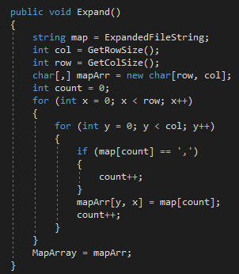
4. Expand File
“Expanding” a file is converting the string from a file into a map array which can be used later on for LevelDesigner. This when a user chooses to load a file (specifically a .txt file) and the Expand() method is called to set up the map as an array instead of a string.
From Filer.cs:

Slide 21
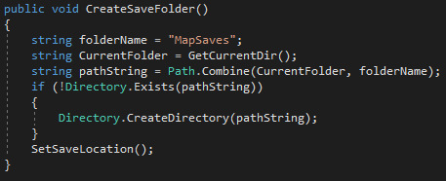
5. Create a default “save” folder for map creations
To make it easier for the user to locate their map creations, the CreateSaveFolder() method creates a folder where all the maps saved as files can be placed in. This would be used by either the methods that load the maps or saves a map. The default folder name is called “MapSaves”.
From Filer.cs:

Slide 22
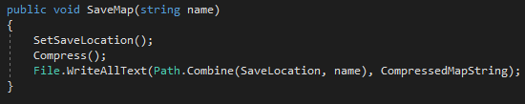
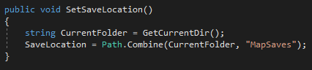
6. Save Map to File
There are three steps to saving a map array to a file. The SaveMap() method calls other methods to achieve this. First, it retrieves the location of where the default folder “MapSaves” is and sets it as the current SaveLocation. Then converts the map array into a string using Compress(). Lastly, it uses a built-in File function to write the string in a file combining the SaveLocation and the name of the file with the compressed string.
From Filer.cs:
From Filer.cs:

Slide 23
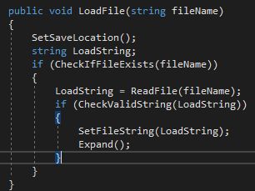
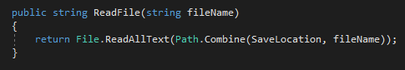
7. Load map from file
When loading a file, the LoadFile() method first sets the save location, checks if the file actually exists, then calls the ReadFile() method to use File’s built-in function to read the contents of the file. It then checks if the strings in the file are valid in terms of their symbols. Finally its sets the strings to a property which then gets used by the Expand() method to convert the string into a map array.
From Filer.cs:
From Filer.cs:

Slide 24
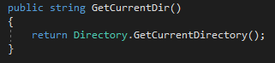
8. Retrieve current directory
Retrieving the current directory is for when it comes to saving and loading the map file. Using the built-in function from Directory, it gets the current directory and sets it as the current folder for the CreateSaveFolder() so that it can be used to set the location of where the default save folder will be placed in.
From Filer.cs:

Slide 25
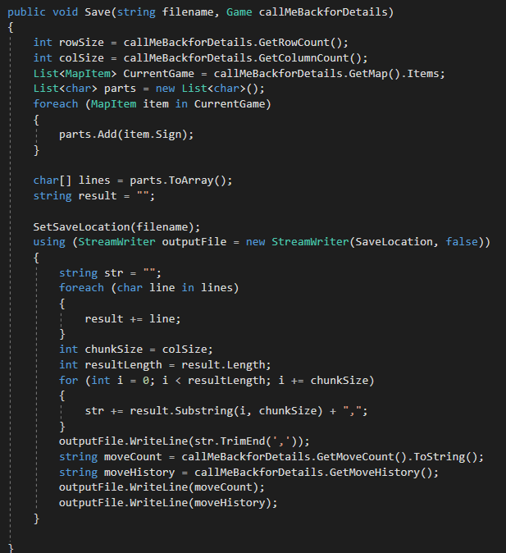


9. save the current game state
*There are two classes that handles the files for game and level designer. This feature relates to handling files in game.
From GameFiler.cs:
The state of a game can be saved by using the Save() method from the GameFiler class. Similar to that of the SaveMap() method in the Filer class but instead, the Save() method includes the details of the current move count and move history into the txt file.
From GameFiler.cs:
This method creates a default save folder called “SavedGameStates” and sets the SaveLocation to be used in the Save() method.

Slide 26



10. Load saved game state
*There are two classes that handles the files for game and level designer. This feature relates to handling files in game.
A saved game state can be loaded back into the game by calling the Load() method. It reads every line in the file and appends each line into a string array. It sets the first item in the array to text which would later be passed on to convert it into a map array. A conditional statement is set after to check if the string array (result) has more than one item, indicating if it has a saved move count and move history. It will set the items in the array to the properties SavedMoveCount and SavedMoveHistory so that it can be retrieved by the main FilerController class.
From GameFiler.cs:
From GameFiler.cs:
From FilerController.cs:

Slide 27


11-12. Get the width and Height of loaded map array
Retrieving the width and height of a map array is essential for when setting up the map when loaded from the file handler. GetRowSize() method counts the number of items in the string of the file horizontally whereas GetColSize() method counts the number of items vertically.
From Filer.cs:
From Filer.cs:

Slide 28

13. Validation Check – if correct file format
The application only accepts one file format to load and display a saved map. So a validation check is needed to ensure that any other file extension not of “txt” will be indicated as invalid and be prevented from loading the contents of the file. This method retrieves the file extension of a given filename using Path’s built-in function and compares it to the valid file format. Not equal to each other will return a Boolean value of False.
From Filer.cs:

Slide 29

14. Validation Check – if file exists
In some cases, a user would give a name of a file that does not exist. To prevent loading a non-existent file and resulting in exceptions and errors, a validation check is made using File’s built-in function “Exists()”. This would be placed before the contents of the file are retrieved.
From Filer.cs:

Slide 30


15. Validation Check – Characters in file are valid symbols
The CheckValidString() method is used to look through each character in the string content from a chosen file, and call the CheckValidSymbol() method to validate if any of the characters are recognized as one of the Parts (Enum). If at least one character is found to be unrecognizable, the file as a whole would be considered as invalid and be prevented from any further steps in the process of loading and displaying.
From Filer.cs:
From Filer.cs:

Slide 31

20. Display any error messages from validation check
Error messages are critical to indicate why a file would be invalid. The validation check methods (shown in the previous 3 slides) are used as part of a conditional If/Else statement. Exceptions would be thrown with their individual string of message when a validation check has failed. For example, the first check being the existence of the file, it would display a message that notifies the user that the file does not exist.
From Filer.cs:

Slide 32
File Handler - View
static lay-out of components

Slide 33
MUST/Should HAVE VIEW – File Handler
Displays a file load dialog
Displays a file save dialog
Displays list of files
Allows to cancel
Provides a path to most recent file
Load a file by a link of most recent saved file
Display error message if file is invalid
Display name of file that is loaded or saved

Slide 34



1. Displays a file load dialog
When a user clicks the Load button in the file handler, it opens up a file load dialog. The code shown below is how the dialog is created with the settings of file type and filter type.
Click on Load button to open file dialog
The message box under Result will indicate if the file has been loaded successfully or not
Select a valid file and click Open button

Slide 35


code
To display the Load button in the FilerForm, its attributes/properties and location are defined. This button is required to display the file dialog to load a file. When Load button is clicked, it triggers the event of opening a file dialog from FilerForm. When a file has been chosen in the OpenFileDialog, it sends the file location and filename to the file handler.
From FilerForm.cs:
From FilerForm.Designer.cs:
Output:
Output:

Slide 36



2. Displays a file save dialog
After user has created a valid map, when a user clicks the Save button in the file handler, it opens up a file save dialog. The code shown below is how the dialog is displayed with the settings of file type and filter type and the default file extension.
The message box under Result will indicate if the file has been saved successfully or not
Click on Save button to open file dialog
Enter a filename for the map creation and click on Save button

Slide 37


code
To display the file dialog which allows a map creation to be saved as a file, it requires the Save button first which is defined in FilerForm.Designer.cs. When clicked on, it triggers the event btnSave_Click() and opens the “SaveFileDialog”.
From FilerForm.cs:
From FilerForm.Designer.cs:
Output:
Output:

Slide 38



3. Displays list of files
The FilerForm has a list box with a heading Saved Files which displays a list of files that have been saved in a folder called “MapSaves”. As each map creation is saved, it will be added to the list box and appear in a new line.
From FilerForm.Designer.cs:
Output of listFiles (list box):
From FilerForm.cs:

Slide 39



4. Allows to cancel
By clicking the Cancel button when the Filer is open, it triggers an event which hides the Filer window. The cancel button is needed as the control box is disabled in FilerForm properties. This limits the user’s choices of handling the Filer window.
Output for Cancel button:
From FilerForm.Designer.cs:
From FilerForm.cs:
Trigger event for Cancel button

Slide 40
5. Provides a path to most recent file
The Filer can display the file path of the most recent file that was saved. The file path is a label that can be updated/overwritten every time a new map creation has been saved.
Output showing the label next to “File Location” label is the generated file path for test_2.txt, a recently saved file.

Slide 41


code
The label that displays the actual file path is defined in FilerForm.Designer.cs with a default text of “None”. When a new file has been saved, the GetRecentFilePath() method is called to overwrite the previous saved file path.
From FilerForm.cs:
From FilerForm.Designer.cs:

Slide 42

6. Load a file by a link of most recent Saved file
In the Filer dialog, there’s a link next to “Recently Saved File” label which when clicked on, it loads the file of a recently saved file, and displays the map in the LevelDesigner form.
Output in LevelDesignerForm:
Output in FilerForm:
Clicking on this link hides the Filer window and sets up the map

Slide 43




Code
This method runs when the events of loading and saving a file has been triggered. It then calls the SetRecentLink() method to set the Text property of the link to the file that was currently saved.
The link is generated and has its properties defined first in order to be displayed on the Filer form
From FilerForm:
From FilerForm.Designer.cs:
From FilerForm:
From FilerForm:
When link is clicked on, it triggers this event which loads the file displayed as a link.

Slide 44


7. Display error message if file is invalid
When loading or saving a file, a validation check is called to check if the file exists, the file format is appropriate, and the strings in the file are valid. If the file fails to pass any of these validation checks, an error message is displayed in the List box under “Result”. In the example below, it would display that the file has failed to load and the reason for why it has failed.
OpenFileDialog:
Filer Dialog showing the results of loading an invalid file:

Slide 45





code
When a chosen file is being loaded, the FileExistsLoaded() runs a check to see if the file exists and if the file format is valid. If it fails, the string “Error: File cannot be loaded” is added to the list box shown in previous slide. For more detailed errors, the GetErrorMessages() method is called by the method which loads the map, SetLoaded() in BaseForm. It passes the errors to the FilerForm (View) which calls the AddErrorsToListBox() and adds each error message to the list box.
From FilerController.cs:
From FilerForm.cs:
The SetErrors() method sets up the string array to be default empty strings instead of null.
From FilerForm.cs:
From Filer.cs:
From Filer.cs:
The AddError() method adds a string to the Errors array which gets passed on to the FilerForm to be added to the list box.

Slide 46




8. Display name of file that is loaded or saved
In the Filer dialog, when a file gets selected. The name of the file gets displayed to indicate to the user which file has been currently loaded. The example below shows “test.txt” being loaded. The Text property of labelLoadItem has been overwritten, from “No Selected Filename” to “test.txt”.
Output in Filer form:
Output in Filer form:
From FilerForm.Designer.cs:
From FilerForm.cs:

Slide 47
Build another Model
Level Designer

Slide 48
MUST HAVE FEATURES – LEVEL DESIGNER MODEL
Generate map (grid) based on user’s desired size
Set selection to wall
Set selection to player
Set selection to block
Set selection to floor tile
Set selection to goal
Add a player element to the map in correct position
Add a block onto the map in correct position
Add a goal onto the map in correct position
Add an empty tile onto the map in correct position
Add a wall to the map in correct position
Replace an already placed element on the map
Map Validation – there must be at least one player
Map Validation– user must add only one player
Map Validation– there must be at least one block
Map Validation– user must add an equal number of blocks and goals
Map Validation – there must be at least one goal
Display error messages
Save a level creation
Edit / Load a level creation

Slide 49



1. Generate map (grid) based on user’s desired size
From LevelDesignController.cs:
Load() method is called to generate the map. The Load() method then calls the SetMap() method which sets the size of the map and sets items.
From LevelDesignController.cs:
The SetSize() method would be called by the LevelDesignController with input parameters based on user’s desired width and height for the map size.
From LevelDesigner.cs:

Slide 50


2-6. Set selection to Wall, player, Block, Floor Tile, Goal
The enumerator (Parts) defines each part as a character. Parts are selected and set dynamically by just referencing them from IFileable.Parts. ‘Item’ is a property which gets set by SetItem() method when a Part has been selected.
From IFileable.cs:
From LevelDesigner.cs:
From LevelDesigner.cs:

Slide 51

6-11. Add a player, block, goal, empty, wall to the map in the correct position
When a part is selected, this chosen part can be placed in the position of x,y on the Map array by calling the PlaceItem() method where x and y are set by the user. It changes the value of an item that used to be in the index of x,y on the Map array to the selected part.
Both from LevelDesigner.cs:

Slide 52
12. Replace an already placed element on the map
A part already placed on the map environment can be replaced simply by overwriting the value in the specific location of the map array. The PlaceItem() method is called, and changes the value to the new item (part) selected, overwriting the previous value.
Both from LevelDesigner.cs:

Slide 53


Map Validation – there must be at least one player
This method checks if a player has been added to the map array by counting the number of player parts within the array and setting a conditional statement of whether its less than 1. If not, it returns a boolean value of False. A player on a goal still counts as whether a player exists on the map.
From Checker.cs:
From Checker.cs:
A method that gets called which counts the number of a specific part in the map array.

Slide 54

14. Map Validation– user must add only one player
The CheckMultiplePlayers() method counts the number of player parts and playerOnGoal parts in the map array and sets a conditional if/else statement that if there’s more than one, it returns a boolen value of False which indicates that the map is invalid.
From Checker.cs:
From Checker.cs:
A method that gets called which counts the number of a specific part in the map array.

Slide 55

15. Map Validation– there must be at least one block
The CheckIfBlockExists() method validates if there is at least one block in the map array. If the CountItems() method gives a result that there is less than 1 (or zero) block/blockOnGoal parts, then a Boolean value of False is returned indicating that its invalid.
From Checker.cs:
From Checker.cs:
A method that gets called which counts the number of a specific part in the map array.

Slide 56

16. Map Validation– user must add an equal number of blocks and goals
The CheckIfGEqualBlocksAndGoals() method validates if there is an equal amount of blocks and goals in the map array. If the number of goals does not equal the number of blocks, the method returns a Boolean value of False and then indicating that the map array is invalid.
From Checker.cs:
From Checker.cs:
A method that gets called which counts the number of a specific part in the map array.

Slide 57

17. Map Validation – there must be at least one goal
The CheckIfNoGoals() method validates if there is at least one goal in the map array. If the number of goals is less than one, the method returns a Boolean value of True and then indicating that the map array is invalid.
From Checker.cs:
From Checker.cs:
A method that gets called which counts the number of a specific part in the map array.

Slide 58



18. Display error messages
Since there are 5 methods to validate certain aspects of the map, the DisplayErrorMessages() method can display 5 or less error messages. The MapErrors() method sets the current map array which will be validated and sets a string array of 5 for any error messages. The ErrorCheck() method would execute because of DisplayErrorMessages() method and set indexes in the array to string messages where the Check…() methods have found an error. IF an error has not been found, the Errors array will be null.
From Checker.cs:
From LevelDesigner.cs:
From Checker.cs:
This method calls methods from Checker class to validate the map and receive any error messages if found.

Slide 59


19. Save a Level Creation
When saving a map creation, the GetMap() method will be called from the Controller to retrieve the current state of the map array containing all the parts in their current positions, and then be handled by the FileHandler to be saved as a txt file.
From LevelDesignController.cs:
From LevelDesigner.cs:
The Controller calls the method from the LevelDesigner class to retrieve map array.

Slide 60


20. Edit/Load a level creation
A saved map can be loaded back to the Level Designer by using the Load() method in Controller which calls the SetMap() method from LevelDesigner. When using the SetMap() method, it overwrites any current map array to allow the map loaded to be displayed and used.
From LevelDesignController.cs:
From LevelDesigner.cs:
The Controller calls the method from the LevelDesigner class to set the loaded map array as the current one.

Slide 61

Screenshot of the Unit Test Results
Level Designer Model

Slide 62
Level Designer - View
DYNAMIC lay-out of components

Slide 63
MUST/Should HAVE VIEW – LEVEL DESIGNER
Display a grid of variable size
Allow selection and placement of a piece
Overlays old piece with new one
Save and load ‘works’ (as in passes to a Filer or NOT)
Useful warnings
No goals
No player
Too many players
Not enough blocks
Any part added to the map displays its corresponding image
Reset map creation
Certain buttons can only be clicked when a map creation is valid

Slide 64


1. Display a grid of variable size
The map is generated after setting a size for the width and height of the level then clicking the ‘generate’ button. The layout of the map is created dynamically through
For the dynamic view, nothing is pre-existing on the form, each item is generated as a form panel type and placed at a specific point on the Map display area.
User can either type a number in the textbox or click on the built-in numeric Up-Down buttons to increase or decrease the width or height. Minimum size is 5x5.

Slide 65





CODE
The mapContainer properties are defined, but appear empty when the Level Designer window is first opened. When “Generate” button is clicked on, it triggers the event, buildMapBtn_Click() which passes the width and height, entered by the user, to the SetUpGrid() method. This method uses a for loop to create each panel according to x and y. The actual creation of the panels is done by CreateGridElements(), and it initially sets the BackgroundImage of the panels to empty.png .
From LevelDesignerForm.Designer.cs:
From LevelDesignerForm.cs:
From LevelDesignerForm.cs:
From LevelDesignerForm.cs:
This method adds the panels to the mapContainer.

Slide 66


2. Allow selection and placement of a piece
There is a selection panel that will only allow a single item to be selected at a time, when something is selected and a position on the map is clicked, the background will change to suit the selected item.

Slide 67


3. Overlays old piece with new one
As each item is placed, it will overwrite the previous value whether it is empty or contains another piece.
When an item has been placed at a new position, that position will display the item image. There are different images set to the different items that can be selected.

Slide 68




CODE
When application first starts, images relevant to the game are added to a dictionary called Items with their relevant Part enum as their key. When any of the radio buttons has been clicked on, it sets the Pic property according to the selected radio button. When the user clicks on a panel in the map environment, it triggers the event, SetImage() which overwrites the current image on the selected panel. SetItem() makes changes to the map array internally, instead of just how its been displayed with SetImage().
From LevelDesignerForm.cs:
From LevelDesignerForm.cs:
From LevelDesignerForm.cs:
From LevelDesignerForm.cs:

Slide 69
4. Save and load ‘works’ (as in passes to a Filer or NOT)
When load is clicked from the view, this will call a static function from the parent form, Main Form, when the function is called, the event is triggered. The triggered event is attached to a delegate, the delegate defines the function that will run when the event is triggered, which is set to the Load() function. After this the file handler takes over.
Within the file handler controller, it will call a static function in the main form that will trigger the event, the event is attached to a delegate that is assigned the function that will then get the loaded array and load it into the level designer

Slide 70




4. Save and load ‘works’ (as in passes to a Filer or NOT)
The Save and Load buttons open the Filer dialog where a map creation can be saved or loaded from. The Save button can only be clicked on after it has gone through the Error Checker. Below is an example of how the “Save” feature works.

Slide 71





Below is an example of how the “Load” feature works.
Result of loading a file:

Slide 72


code
This is the Program.cs file which allows the application to run. The Filer object gets injected into the FilerController object along with the FilerView and GameFiler(used for only game). The LevelDesigner object gets injected into the LevelDesignController with its LevelDesignView object. To associate/connect both the LevelDesigner and Filer together, the LevelDesignController and FilerController is injected into the Base Form object which then gets used as an input parameter to run the program.
From Program.cs:

Slide 73

This shows the result of passing the two controllers, FilerController and LevelDesignController to the BaseForm from Program.cs
From BaseForm.cs:

Slide 74





When either the Save or Load button is clicked from the view, it will call a static method from the parent form, BaseForm. And when this method is called, an event is triggered. The triggered event is attached to a delegate which defines the method that will run when the event is triggered, setting it to either the ToSave() method or ToLoad() method. When either these methods are called, the Filer takes control of the file handling process.
From BaseForm.cs:
From LevelDesignerForm.cs:
From BaseForm.cs:
From BaseForm.cs:
From BaseForm.cs:

Slide 75
5. Useful Warnings
Before a map creation can be saved, it must go through an error checker which tests for the following:
If a player exists
If there no are multiple players
If a block exists
If a goal exists
If there is an equal number of blocks and goals
If the map creation fails to pass any of these checks, an error message relevant to its failed check will be added and displayed in the list box under the Error Checker label.

Slide 76



These are different examples of when a map creation fails to pass the Error Checker by clicking the Check button.
Example 1: Nothing is added
Example 2: Multiple players
Example 3: Unequal numbers of goals and blocks

Slide 77





As Check button is clicked on, it triggers errorCheckBtn_Click() which then triggers the MapChangedEvent, calling the SetMap() method and setting up the errors for the view. The DisplayErrorMessages() calls the method ErrorCheck() to add any strings where a check has failed to the string array Errors. The string array then gets passed back to the view, which then adds each string element containing an error message to the list box (errorListBox).
From LevelDesignerForm.cs:
From Checker.cs:
From LevelDesigner.cs:
From LevelDesignController.cs:
From LevelDesignerForm.cs:

Slide 78


7. Reset Map creation
A map creation can be cleared automatically by clicking the Reset button which sets all the panels to the empty tile.

Slide 79



code
When the Reset button is clicked on, it triggers the resetBtn_Click(), which then calls the Clear() to remove all the panels in mapContainer. Then it sets Pic to the value of the “empty” character and finally calls the SetUpGrid() method to create the panels again.
From LevelDesignerForm.cs:
From LevelDesignerForm.cs:

Slide 80
8. Certain buttons can only be clicked when a map creation is valid
When the LevelDesigner window first opens, only a few buttons are enabled and available to be clicked on. When a map is generated, more buttons are enabled. When the map passes the error checker, the file handling buttons are the last to enabled. The following shows at what levels certain buttons have been enabled:
Initial = Generate, Load, Reset, Cancel
Generate -> Check
Check -> Save (if valid), Test

Slide 81




Slide 82









code
From errorCheckBtn_Click() in LevelDesignerForm.cs:
From Start() in LevelDesignerForm.cs:
When Check button is clicked on (If no errors found):
When the application runs, these buttons are disabled:
From buildMapBtn_Click() in LevelDesignerForm.cs:
When Generate button is clicked on:

Slide 83
Theory
Describe and use common design patterns, Algorithms and programming language idioms
Design Programs

Slide 84
Describe and use common design patterns, Algorithms and programming language idioms
MVC
The model-view-controller (MVC) design pattern specifies that an application consist of a data model, presentation information, and control information. The pattern requires that each of these be separated into different objects.
The model contains only the pure application data; it contains no logic describing how to present the data to a user.
The view presents the model's data to the user. The view knows how to access the model's data, but it does not know what this data means or what the user can do to manipulate it.
the controller exists between the view and the model. It listens to events triggered by the view (or another external source) and executes the appropriate reaction to these events. In most cases, the reaction is to call a method on the model.
Reference:
https://www.ibm.com/support/knowledgecenter/en/SSZLC2_9.0.0/com.ibm.commerce.developer.doc/concepts/csdmvcdespat.htm

Slide 85

Describe and use common design patterns, Algorithms and programming language idioms
MVC Example – Class Diagram of how I implemented the LevelDesigner system.
The LevelDesignerForm/ ILevelDesignView invokes action to the LevelDesignController which then requests the LevelDesigner to modify its data. When LevelDesigner has made the request modifications, it notifies the LevelDesignController and sends the updated/displays information to the LevelDesignerForm through ILevelDesignView.

Slide 86




Code Example
Model - LevelDesigner.cs
Injects the View and Model into the Controller – Program.cs
Updates
View - ILevelDesignView.cs
Notifies
Controller – LevelDesignController.cs
Updates
Uses
Invokes action
View – LevelDesignerForm.cs
There are two parts to the view. ILevelDesignView is just an interface which gets utilized by the controller. LevelDesignerForm is where the actual data gets viewed by the user or where the user interacts with the application

Slide 87
Evaluation of approach/Improvements
The MVC approach separates the responsibilities of interacting with the user, modifying data, and passing information around. For Example, The LevelDesignController modifies the model (Level Designer) with the data that was retrieved from the view (LevelDesignView). Which then passes new information notified by the model to the view.
It was simple to understand and implement when drawing out the class diagram and then coding the system based on the design.

Slide 88
DESIGN Programs
Wireframes
As you can see in the picture below, a wireframe is a low-fidelity, simplified outline of your product. You can usually recognize them by their distinctive block layouts, use of lines to represent text, and “✕” squares indicating placeholders for future images.
Reference:
https://www.uxpin.com/studio/ui-design/what-is-a-wireframe-designing-your-ux-backbone/

Slide 89


Examples
Here are two wireframes designed to be a VIEW for the Sokoban Game Dialog and Level Designer Dialog:

Slide 90
Evaluation/Improvement
There is enough information in the wireframes to get started on creating the Windows Forms for LevelDesigner and Game.
The wireframes do not show enough depth/detail such as when a button is clicked, what does the application display next. E.g. When a user clicks the Load button in LevelDesigner Form, an OpenFileDialog form is displayed. There should be more wireframes.
These wireframes are more static.
Suggested improvement: Creating wireframes for each button that displays different appearances that a user would actually see. Show the dynamic/interactive side of the application by adding arrows to direct.

Slide 91
Alternative Approaches
Storyboards – “ can strengthen the user experience elements of designs” http://www.iamwire.com/2017/05/storyboarding-software-design-process/153220
Priority Guides - “creating a single deliverable that provides directions for content-focused design” - https://www.smashingmagazine.com/2012/05/design-process-responsive-age/

Slide 92
Design user interfaces which conform to recognised usability criteria
Grouping and Ordering
Grouped objects should appear together, possibly visually separated from other controls, and controls which have a logical sequential ordering should appear in that order.
References:
https://smartech.gatech.edu/bitstream/handle/1853/3582/94-03.pdf;sequence=1

Slide 93



Grouping Example
This is a screenshot of the LevelDesignerForm. By using groupBoxes, I could group sections of controls(labels and buttons) based on their relevancy and association. E.g. The numeric inputs for width and height are associated with entering a map size. The “Generate” button is used to display the results based on the width and height inputs. Codes from LevelDesignerForm.Designer.cs.
The mapSizeContainer holds 5 controls:
Generate button
Width label
Height label
Width Numeric inputBox
Height Numeric inputBox
The mapElementsContainer holds 7 controls:
Wall radio button
Player radio button
Block radio button
Goal radio button
Player on Goal radio button
Block on Goal radio button
Empty tile radio button

Slide 94
Ordering Example
Again, using the LevelDesignerForm as an example. There is a sequential form of ordering in this view which eases/guides the user to create a map without the need of more detailed instructions/steps. The ordering of the controls is from top to bottom, left to right.
Starting from the top, a user is required to enter a width and height for the map size. The next step is to click “Generate” which just sits below the inputs. The next step is adding map items to the empty map. Below the map item selections is the error checker, which in terms of process, occurs after user is done with adding map elements. The user is guided to click “Check” to validate the map. Next, the user can save the map with “Save”. Or the user could click on “Test” to test the map creation before saving. Below all these controls are the “less important” (optional) buttons but still necessary. The Reset button sits at the bottom to prevent the user from an accidental click during the creation process. The Cancel button has a similar reason as well. But also with the reason that it’s the very last thing a user would do (or first). The Cancel button is positioned to be on the right hand side to indicate this specific reason.
Step 1
Step 2
Step 3
“Optional” Step – can occur in the beginning and opting out steps 1-3
Step 4
“Optional” Step – can occur anytime but is usually last

Slide 95
Evaluation/Improvements
The way that the controls have been laid out in LevelDesignerForm seem to justify itself why they are positioned the way they are. It’s easy for the user to flow through the process of designing a level without the need for any proper instructions.
A good user experience design requires a certain grouping hierarchy. To be organized and ordered that a user wouldn’t be finding difficulties of how the application works.
I don’t see a need for any improvements on grouping and ordering in the current design of the LevelDesignerForm.

Slide 96
Self-Marking Sheet - CODE
CODE | EXPECTED MARKS | REASON
Static View – Game Player | 8 | Done 5 must-have + 3 should-have features
File Handler Model | 6 | Completed only 15/20 MUST features
Dynamic View – File Handler | 8 | Done 5 must-have + 3 should-have features
Level Designer Model | 8 | Completed all 20 MUST features
Dynamic View – Level Designer | 8 | Done 5 must-have + 3 should-have features
Total Marks: 38/40

Slide 97
Self-Marking Sheet - THEORY
TOPICS | EXPECTED MARKS | REASON
Describe and use common design patterns, Algorithms and programming language idioms | 3.5 | Didn’t complete the alternative approaches section as well as the improvement section.
Design Programs | 3.5 | Incomplete section of alternative approaches to wireframes
Design user interfaces which conform to recognised usability criteria | 4 | Incomplete section of alternative approaches
Total Marks: 11/15

